Slide 1
Introduction to Quantum Computing: From a Layperson to a Programmer in 30 Steps
Hiu-Yung Wong
https://link.springer.com/book/10.1007/978-3-030-98339-0
https://www.amazon.com/Introduction-Quantum-Computing-Layperson-Programmer/dp/3030983382
Playlist: https://www.youtube.com/watch?v=kbjG9v1T-k8&list=PLnK6MrIqGXsJfcBdppW3CKJ858zR8P4eP&index=25
https://www.youtube.com/watch?v=GB9wsUw0aVc&list=PLnK6MrIqGXsJfcBdppW3CKJ858zR8P4eP&index=26

Slide 2
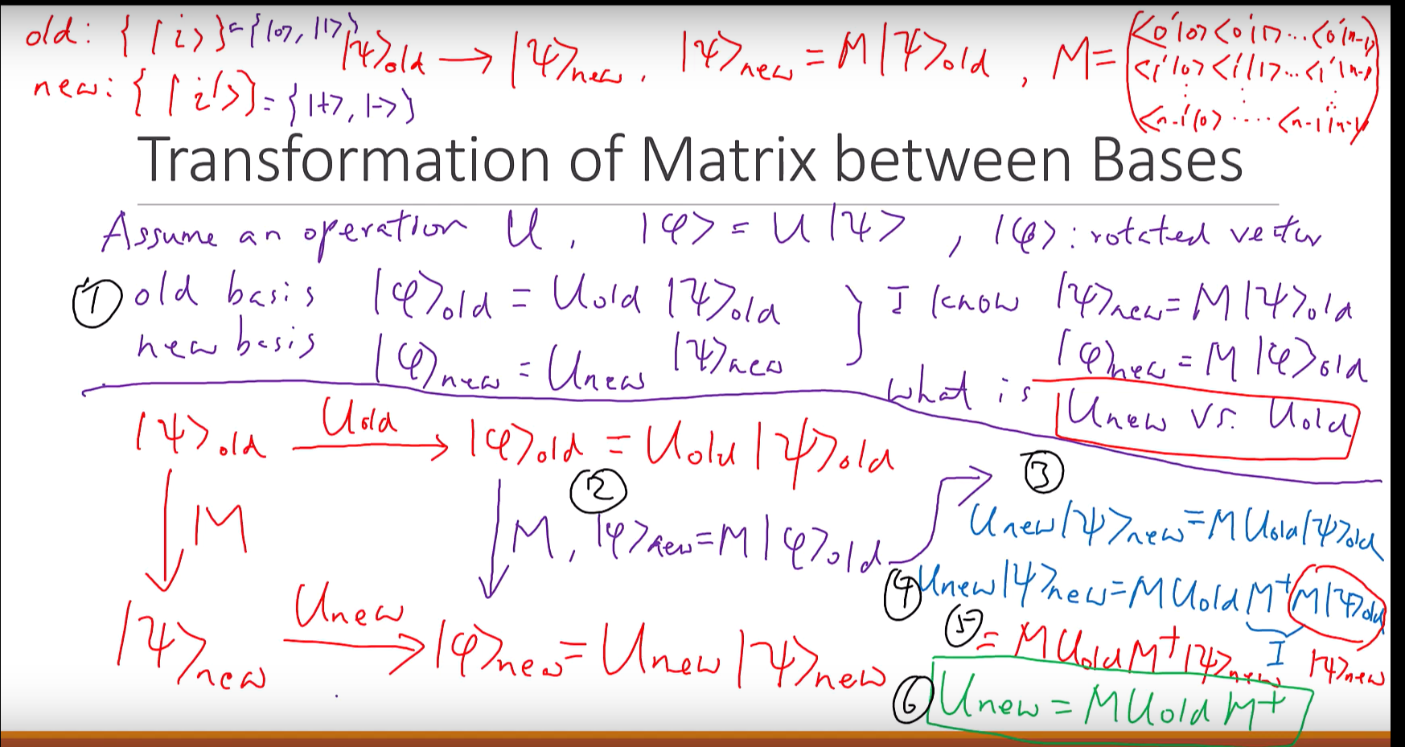

Slide 3

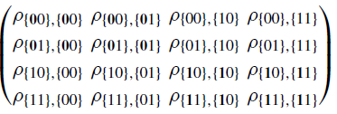
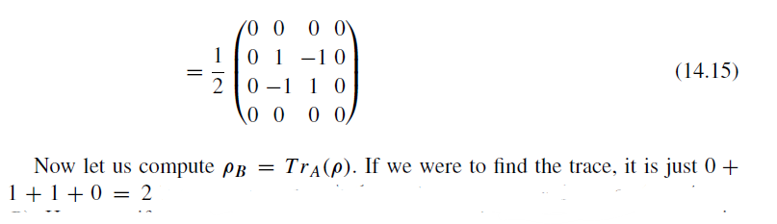
Trace
Tr(AB) = BA

Slide 4
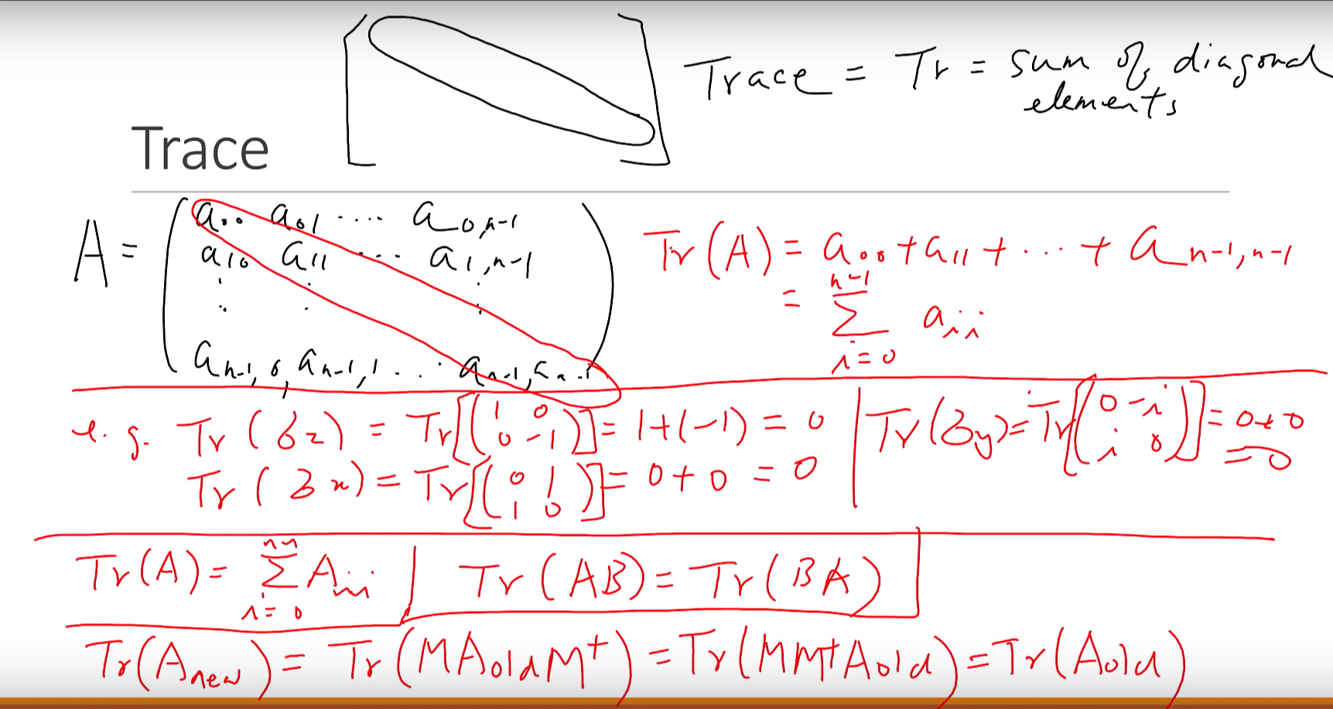

Slide 5





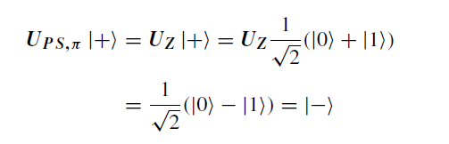
1-Bit Phase Shift Gate
Definition
And this is just the σz matrix, one of the important Pauli matrices. And it is also called the Z-gate.

Slide 6

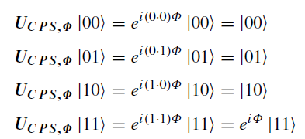
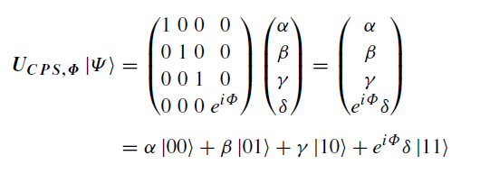
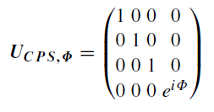
2-Bit Phase Shift Gate (Controlled-PS)
Definition

Slide 7
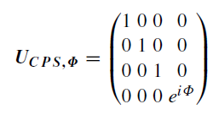

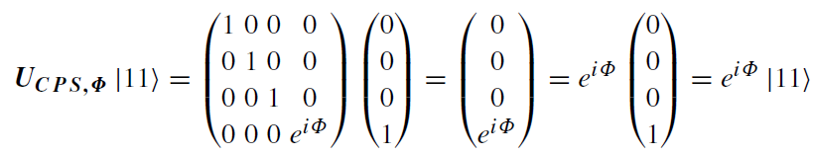
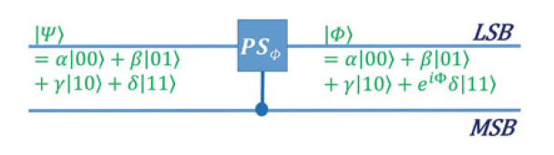
A is Control Qubit
B is Target Qubit

Slide 8

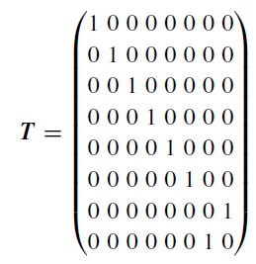
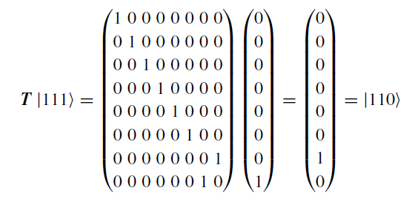
Toffoli (Controlled-Controlled NOT, CCNOT) Gate (3-qubit)
Toffoli gate can be used as universal gate in classical circuit

